Slide 1
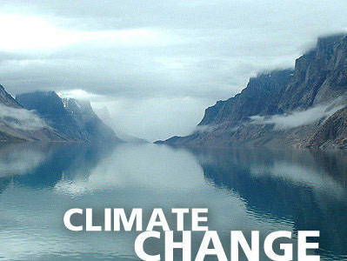
Elspeth, Lily, Olivia, Alma, Adele, Mollie, Millie, Martha,
Lizzie, Eden (Scotland)
Phillip, Alex (Germany)
Eszter (Hungary)
Jóhanna (Iceland)
Karoline, Regine (Norway)
Lousie, Sander (Belgium)

Slide 2
The Effect of Climate Change On Our Countries

Slide 3
Belgium
In Belgium, over the course of the 20th century, there were very marked and quite severe increases in seasonal and annual temperatures (in the order of 1°C) during two periods, firstly during the first half of the 20th century and then In the 1980s
the frequency of cold spells reduced significantly in the early 1970s. The general increase in minimal temperatures during the 20th century also explains why the longest annual period without frost has increased
Between 1833, when rainfall records began, and the end of the 20th century, the Brussels region has seen an increase of roughly 7% in annual rainfall

Slide 4
Estonia
Estonia lies in the transition zone between maritime and continental climate. Local climatic differences are due, above all, to the neighbouring Baltic Sea, which warms up the coastal zone in winter and has a cooling effect, especially in spring.
The most intensive warming to date has taken place in March, April, and May, with a gradient of 1.5ºC per 100 years
Since 1966 precipitation series in Estonia have been massive. A significant increase in precipitation has occurred in winter period (29%). During the period 1961–2004 the winter seasonal precipitation increased over 45 mm.

Slide 5
Germany
The annual average temperature increased by ca. 0.8 to 1.0ºC between 1900 and 2000. After a cooling trend up to the 1970s, we now observe a continuous and rapid temperature increase that still continues today
The intensity and frequency of occurrence of extreme rainfall events have increased especially during the last forty years of the 20th century. In general, this trend is more pronounced in the winter than in the summer
The probability of occurrence of an extremely hot summer, such as in the year 2003, has increased in the course of the 20th century

Slide 6
Hungary
Precipitation
Its annual amount significantly decreased in the 20th century.
This is most significant during spring when it is only 75% of the sum in the beginning
of the 20th century
The autumn and winter precipitation decrease is 12-14%.
The winter precipitation is the lowest in comparison to the other seasons.
Temperature
The number of frosty days is expected to decrease with 12-15 days by 2040 compared
to the period between 1961-1990, everywhere – more in higher altitudes
Fewer frosty days will result in a decrease in heat consumption higher temperatures
mean a shorter heating period.
The number of days with high heat alert will increase
The largest temperature increase is expected in summer, and the smallest increase in
spring. The expected summer warming of Hungary in 2071- 2100 compared with
1961-1990 ranges from 4.5-5.1°C 3.7-4.2°C .
In case of spring, the expected increase inside Hungary is 2.9-3.2°C

Slide 7
Iceland
Iceland enjoys a warmer climate than its northerly location would indicate because a part of the Gulf Stream flows around the southern and western coasts of the country. Reykjavik has a cool climate; with annual temperatures similar to those of Toronto or New York. However, it does still get cold in Reykjavik.
In addition, the result of mixing the warm, moist Atlantic air with the cold, dry Arctic air produces a weather pattern that is constantly changing. The annual temperature of Reykjavik is 5°C, with the average January temperature being -0.4°C and July 11.2°C. The temperature records for Reykjavík are 24.8°C (76.6°F) on August 11, 2004 and -24.5°C (-12.1°F) on January 21, 1918 (1).
In the 1920s there was a period of rapid warming, similar to what is observed in global averages, but in Iceland the temperature change was greater and more abrupt. Since the 1980's, Iceland has experienced considerable warming, and early in the 21st century temperatures reached values comparable to those observed in the 1930s.

Slide 8
Norway
For the period 1900-2008 as a whole, the annual mean temperature in Norway has increased by about 0.9°C
The annual precipitation has increased in Norway during 1900-2008#
Snow cover has decreased in the northern hemisphere for the past 50 years
Snowfall depends strongly on temperature and precipitation. In Norway, these have increased during winter in the past few decades.
The Norwegian coastal glaciers, which were expanding and gaining mass due to increased snowfall in winter up to the end of the 1990s, are also now retreating, as a result of less winter precipitation and more summer melting (12, 13). Nearly all the smaller Norwegian glaciers are likely to disappear and overall glacier area as well as volume may be reduced by about one third by 2100

Slide 9
Scotland
The Gulf Stream has a warming effect on the UK, especially bringing mild winters for its latitude.
From 1901 to 1999, annual mean CET temperatures showed a warming of +0.6°C over this period. The warming has been greatest from mid-summer to late autumn.
Temperatures in Wales, Scotland and Northern Ireland have risen by about 0.7–0.8ºC since about 1980.
Scotland is on average 20% wetter then it was in 1961

Slide 10
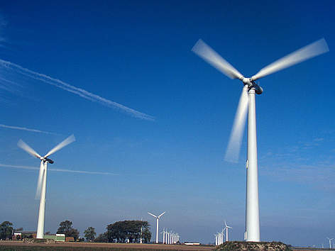
Solutions to lessen climate change

Slide 11
Fuel Economy
Highway vehicles release about 1.5 billion metric tons of greenhouse gases (GHGs) into the atmosphere each year.
You can reduce them by:
Choosing a car with better gas mileage
Getting the best fuel economy out of your car
Using a low-carbon fuel such as ethanol or CNG
Walking, biking or taking public transport more often
Combining trips when possible

Slide 12
Clean Energy
Two thirds of all energy going into the UK’s power stations is lost as waste heat energy. If we captured this heat, it would be enough of to heat every building and business in the UK.
To capture this energy we would need to start using smaller plants, however, by making these changes we could double the efficiency of our power stations, slash our carbon emissions and reduce our reliance on foreign gas.

Slide 13
In The Home
Domestic usage accounts for 15% of the UK’s carbon emissions.
There are many simple solutions that one can do such as switching to energy efficient bulbs and fitting insulation in the loft, etc.
But we can go further by decentralising our energy systems. By installing small scale solar and wind generators we can make our own power and even sell our excess energy to top neighbours etc.

Slide 14
Industry
In 2005 the EU Emissions Trading Scheme (EU ETS) was set up to tackle emissions from industry, which accounts for almost a quarter of the UK’s carbon emissions.
The ETS requires companies to either reduce their emissions or buy carbon credits from other companies that have exceeded their targets.

Slide 15
Top Ten Small Solutions
Reduce, Reuse, Recycle
Use Less Heat and Air Conditioning
Change Light Bulbs to Fluorescent
Drive Less and Drive Smart
Buy Energy-Efficient Products
Use Less Hot Water
Use the “OFF” Button
Plant a Tree
Manage Your Utilities
Encourage Others to Conserve
http://www.youtube.com/watch?v=OqVyRa1iuMc

Slide 16
In 50 years…
“It’s virtually certain that human activities are responsible for the changes in climate that we’ve been seeing over the past 50 years.”

Slide 17
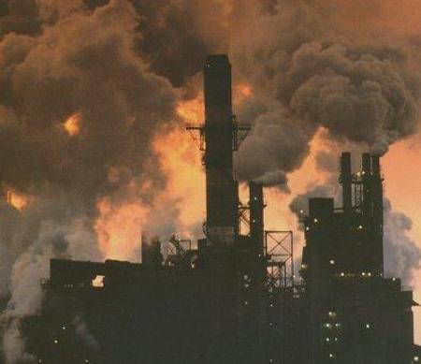
Climate in 50 years time…
Persistent emissions of greenhouse gases will lead to increasing levels of climate change; this can include atmospheric warming, rising acidity levels in the ocean, rising sea levels, and changing precipitation patterns.
The extent of future climate change is dependent on what we do now to reduce global warming. The more global warming we cause, the larger the changes will be.

Slide 18
References
http://www.epa.gov/climatechange/science/future.html
http://www.50yearforecast.org/
http://www.telegraph.co.uk/earth/earthnews/6236690/Met-Office-catastrophic-climate-change-could-happen-with-50-years.html
http://www.climateadaptation.eu/
http://www.greenpeace.org.uk/climate/solutions
http://environment.about.com/od/globalwarming/tp/globalwarmtips.htm
http://www.fueleconomy.gov/feg/climate.shtml
http://en.wikipedia.org/wiki/Effects_of_climate_change_on_humans
http://www.theguardian.com/environment/2012/sep/19/climate-change-affect-food-production
http://www.scientificamerican.com/article.cfm?id=population-growth-climate-change
http://www.greenpeace.org/international/en/campaigns/climate-change/impacts/sea_level_rise/

