Slide 1
Green Cities
Réka Harai
Viktor Vande Kerckhove
Simon De Ruyck
Andris Fébó

Slide 2
European Green City Index
Definition
Since 2009
120 cities

Slide 3
What is the EIU?
Economist Intelligence Unit
An independent business within The Economist Group
Made a ranking based on indicators

Slide 4
The Green City Index series …
30 indicators across eight to nine categories depending on the region
Covers: CO2 emissions, energy, buildings, land use, transport, water and sanitation, waste management, air quality and environmental governance

Slide 5
Best city: Copenhagen
Capital of Denmark
Top 5 categories, except waste and land use
Limiting carbon-emission
“world’s best cycle city”

Slide 6
Interesting facts:
Country | Capital | Fact
Germany | Berlin | Copenhagen’s and Berlin’s residential buildings consume almost 40% less energy than the Index average
Estonia | Tallinn | Tallinn consumes the least amount of water – only 138 litres per person per day, compared with the Index average of 288 litres
Norway | Oslo | It uses the highest share of renewable energy at 65%. The Index average is 7%. Also among developed cities in the Indexes worldwide, Oslo emits the lowest amount of CO 2, at 2.2 tonnes per capita. This is compared to the European average of 5 tonnes and the US and Canada average of 15 tonnes

Slide 7
Index
Ranking | City | Score
1. | Copenhagen | 87.31
3. | Oslo | 83.98
8. | Berlin | 79.01
9. | Brussels | 78.01
11. | London | 71.56
16. | Warsaw | 59.04
17. | Budapest | 57.55
23. | Tallinn | 52.98
Over 30 | Edinburgh | Less than 52
 | Reykjavik

Slide 8
Budapest
CO2 emission: 17th place
Buildings: 20th place
Waste and land use: 15th place

Slide 9
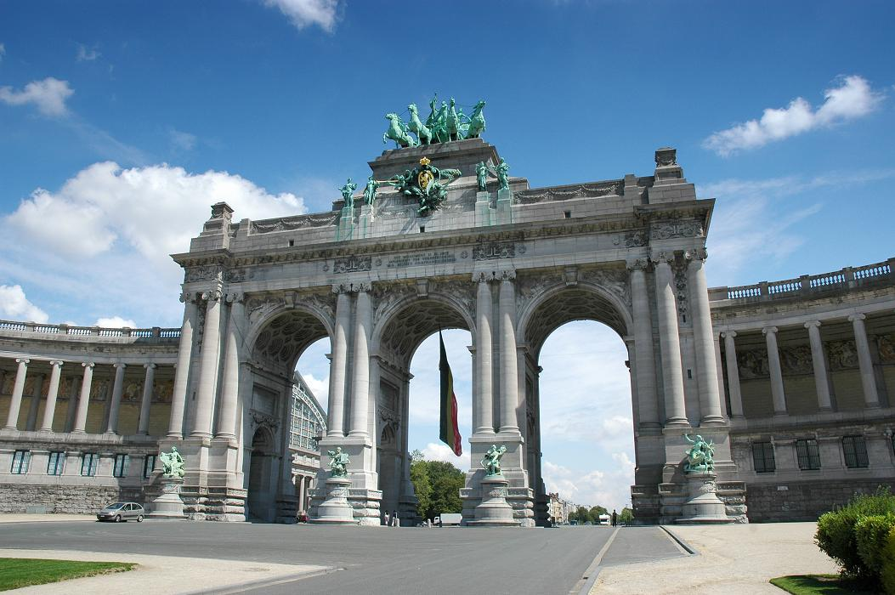
Brussels
CO2 emission: 5th place
Energy use: 8th place
Renewable energy consumption: 24th place
Transport: 7th place
Green Tuesdays

Slide 10
How to be greener?
Cars < Bicycles
Renewable energy, bio fuel
Green policy

Slide 11
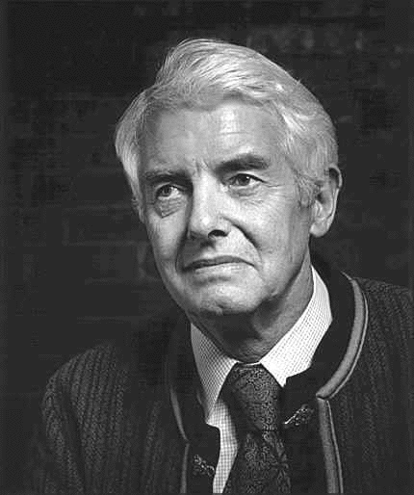
“We do not inherit the Earth from our ancestors; we borrow it from our children.”
David Brower

Slide 12
Thanks for your attention!

Slide 13
Sources:
http://www.siemens.com/press/pool/de/events/2012/corporate/2012-06-rio20/gci-report-e.pdf
https://www.cee.siemens.com/web/ro/ro/corporate/portal/SiemensRomania/Organizatie/desprenoi/Documents/European_Green_City_Index.pdf

