Slide 1
The Great Energy Challenge
Made by: Rik Vanlerberghe
Vincent Locquet
Rudolf Balázs
Szabolcs András

Slide 2
Historic statistical data from the 19th century to today of water and energy usage
Comenius
The great energy challenge

Slide 3
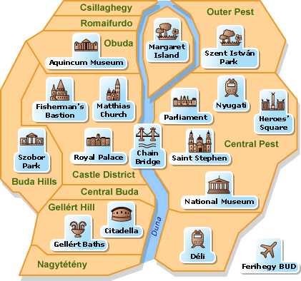
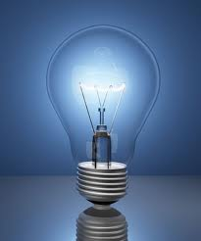
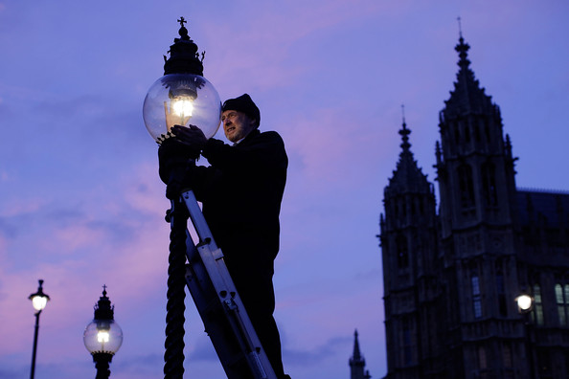
Lighting
Hungary
-In 1872 Pest, Buda and Óbuda were united and formed Budapest.
-At that time gaslamps were used in the street.
-In 1873 the first electric lights were installed, and they have been being used since that time.
Comenius
The great energy challenge

Slide 4
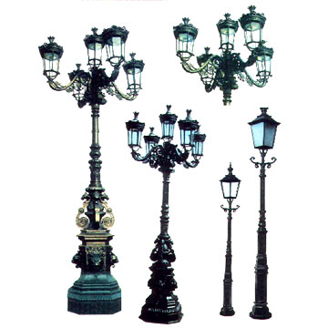
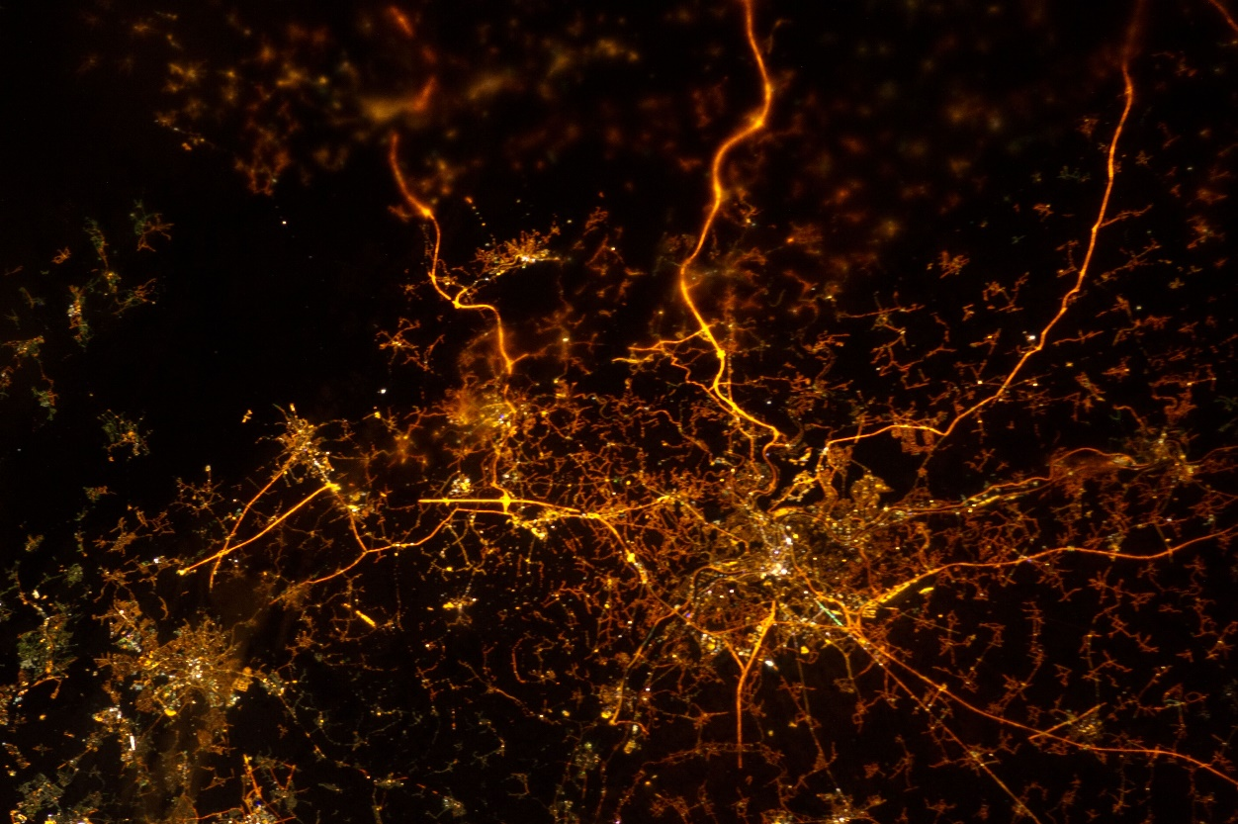
Lighting
Belgium
In the 19th century the first towns were lit by electric streetlights. They were safe and could be lit all at once.
The lamp posts were made of wood but after the world war they were replaced with steel or aluminium ones.
Now almost every street is illuminated, including motorways!
Comenius
The great energy challenge

Slide 5
Electricity consumption
Comenius
The great energy challenge

Slide 6
Heating
-The flats were heated with iron stoves or tiled stoves, but only the living room.
-In Hungary coal and wood heating was common, gas became used after the WW 2.
-Heating fuels were stored in the basement.
Comenius
The great energy challenge

Slide 7
 |  | Mr.Balázs 3 | Mr.Tatárka 3 | Mr.András 3 | Mr.de Ruyck 5 | Mr.de Craemer 4 | Average Hungarian Consumption 4 | Average Belgian Consumption 4
Elecricity |  | 350 kw | 115 kw | 166kw | 414kw | 112kw | 150 kw | 391kw
Type of building |  | detached | flat | detached | detached | detached | Block of flats | Detached houses
Building materials |  | brick | brick | entong | brick | brick | brick | brick
No of windows |  | 18 | 3 | 50 | 15 | 40 | 5 | 15
Number of cars |  | 2 | 1 | 2 | 4 | 2 | 1 | 2
Number of bikes |  | 3 | 4 | 4 | 8 | 6 | 2 | 4
Type of heating |  | gas | Central from afar | gas, geothermal | oil, wood | oil | Gas central heating | oil
Preferred temperature |  | 21 | 20 | 24 | 21,5 | 21,5 | 22 | 21,5
Comenius
The great energy challenge

Slide 8
Water

Slide 9
Comenius
The great energy challenge

Slide 10
Carbon emission
Comenius
The great energy challenge

Slide 11
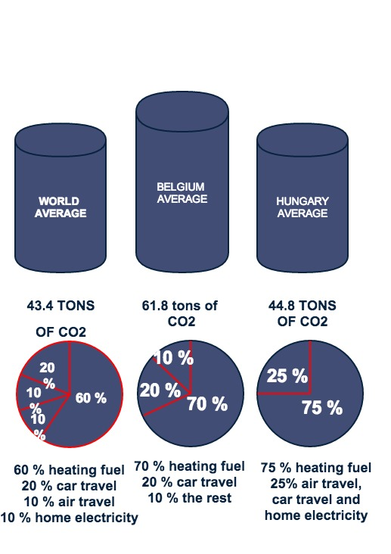
Comenius
The great energy challenge

Slide 12
Environmentally friendly
energy sources and transportation
In Hungary in 2010 3,6% of the energy was renewable and 5,75% of the fuel used was biofuel.
Till 1980 energy consumption grew, but since then there has been a decline in industry, so energy consumption dropped.

Slide 13
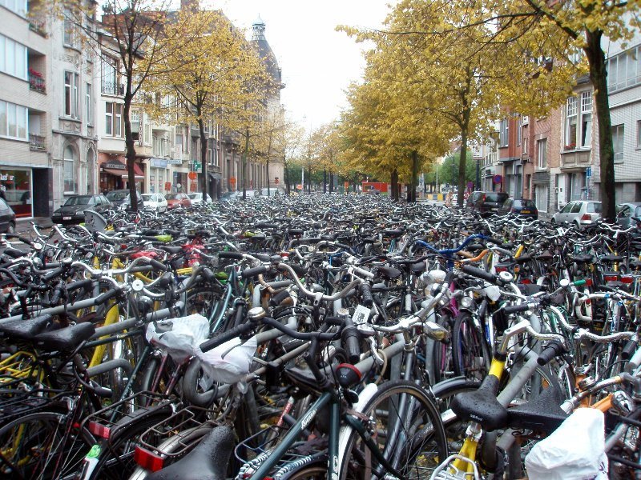
Cycling
Belgium
Belgium, Gent
-promoted by employer
-0,19 EUR/km (60 HUF)
-only for working people, for students not

Slide 14
Cycling in Belgium
-Promoted by government
-19 Eurocents/km
-only for employees not for students

Slide 15
Comenius
The great energy challenge

Slide 16
SOURCES
https://www.google.hu/
http://environment.nationalgeographic.com/environment/energy/great-energy-challenge/
http://www.wikipedia.org/
http://en.wikipedia.org/wiki/History_of_Budapest
http://www.fietsroute.org/indexuk.php
http://www.worldometers.info/water/
Comenius
The great energy challenge

